Slide 1

C Training
TTTech Auto
Confidential and Proprietary Information
November 6, 2020

Slide 2
Prerequisites:
Experience in any programming language
A computer with an Internet connection
Material:
Theory + Examples + Exercises https://github.com/lucianotttech/C_Training
External resources:
Online compiler for C/C++ https://www.onlinegdb.com/
Trainers:
Pablo Severini pablo.severini@tttech-auto.com
Luciano Curti luciano.curti@tttech-auto.com

Slide 3
Contents
01 | Introduction | 05 | Dynamic memory
02 | Datatypes | 06 | Lists and recursion
03 | Pointers | 07 | Finite State Machines
04 | Modularization | 08 | Threads

Slide 4
Introduction
01
02

Slide 5
Introduction
'C’ language is not design for an specific hardware.
"Middle-level", combines high level language characteristic with low level lenguaje characteristics like direct memory access.
Some characteristics:
Imperative (commands for the computer to perform)
Compiled (implementations are typically compilers, and not interpreters)
Structured (use of selection and repetition, block structures, and subroutines)
Strongly typed (has stricter typing rules at compile time)
Against ASM offers:
Reliable.
Scalable.
Portabilty.
Manteinable.

Slide 6
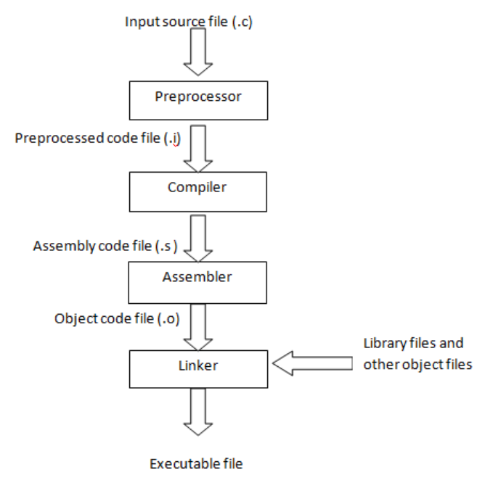
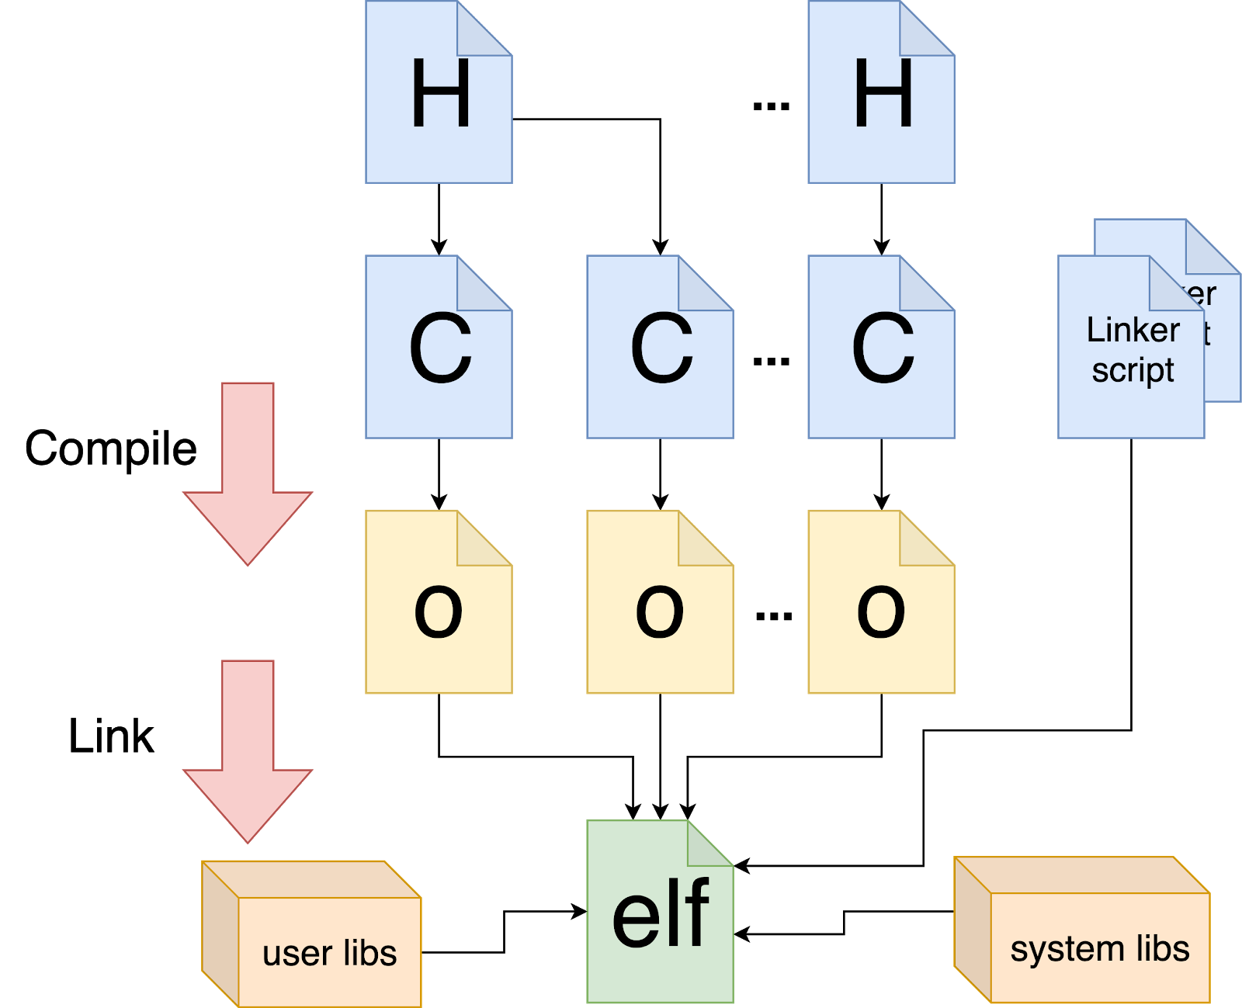
Compilation process
4 different files:
Source code files .c
Header files .h
Object files.o
Executable binary file .axf or .elf
Embedded model

Slide 7
Preprocesor directives
#define NAME [value]
#include <file.h>
#include “file.h”
#ifndef SIMBOL
#define SIMBOL
...
#endif
Some of the most used libraries:
#include <stdio.h> // Printf, scans, files
#include <string.h> // String manipulation
#include <stdlib.h> // Numerical conversions, random…
#include <math.h> // Math functions
#include <errno.h> // Errors, exceptions
#include <time.h> // Date, time
#include <stdint.h> // Set of integral type aliases

Slide 8
Datatypes
Address | Content | Type | Size | Value (HEX) | Value (Dec)
90000000 | FF | int | 4 bytes | 0x000000FF | 255
90000001 | 00
90000002 | 00
90000003 | 00
90000004 | FF | short | 2 bytes | 0x01FF | 511
90000005 | 01
90000006 | 00 | double | 8 bytes | 0x3F88000000000000 | 1.171875e-2
90000007 | 00
90000008 | 00
90000009 | 00
9000000A | 00
9000000B | 00
9000000C | 88
9000000D | 3F
9000000E | 00 | int * | 4 bytes | 90000000 | 2415919104
9000000F | 00
90000010 | 00
90000011 | 90
The bits assigned for each type will depend on the architecture for which you compile.
Integers:
Char (1 byte)
Double (8 bytes)
short int (2 bytes)
Int (4 bytes)
long int (8 bytes)
*32 bits architecture
Typedef allows you to define new datatypes: typedef old_type new_type;
Notes:
Float 32 bits: https://en.wikipedia.org/wiki/Single-precision_floating-point_format
Float 64 bits: https://en.wikipedia.org/wiki/Double-precision_floating-point_format IEEE-754 Floating-Point Conversion online: https://babbage.cs.qc.cuny.edu/IEEE-754.old/64bit.html

Slide 9
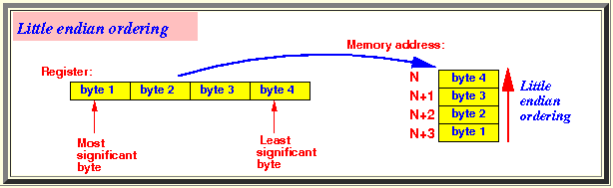
Standard datatypes
#include<stdint.h>
Same size datatypes independent from the architecture.
uint8_t, uint16_t, uint32_t, uint64_t (unsigned).
int8_t, int16_t, int32_t, int64_t (signed).
#include<stdbool.h>
Boolean type
bool_t

Slide 10
Scope
Local:
Are declared inside the function.
Access allowed only from inside the function where they were created.
Allocated inside registers or function stack.
Global:
Are not declared inside any function.
Can be accesed from anywhere. Except for static declared ones.
Are allocated in fixed RAM addresses.
Note: Using same names, a local variables have priority against global ones.

Slide 11
Cast
Will allow you to indicate a temporary data type change
int z; // ‘z’ declaration
int x = 100; // ‘x’ declaration & initialization
char y = 63; // ‘y’ declaration & initialization
z = ( y * 10 ) + x;
z = ( (int)y * 10 ) + x;

Slide 12
Constants
Literal and symbolics.
#define PI 3.1416
const char c = 57;
Prefix and subfix:
0, 0b, 0x,
U, L, UL, F
Special chars:
\n // Insert new line
\r // Carriage return
\t // Insert TAB
\b // Backspace
\\ // Insert one ‘\’
\’ // Insert one ‘
\” // Insert one “
\0 // NULL chacarter
Commands to be use with printf() & scanf()
printf("%d", var_int); // Integer
printf("%ld", var_int); // Long integer
printf("%u", var_int); // Unsigned integer
printf("%nd", var_int); // Integer with ‘n’ digits
printf("%x", var_int); // Hexadecimal
printf("%X", var_int); // Hexadecimal UPPERCASE
printf("%p", var_ptr); // Memory location in Hexa
printf("%f", var_float); // Float in decimal notation
printf("%4.2f", var_float); // Float with 4 digits + 2 decimal
printf("%e", var_float); // Float in exponential format
printf("%g", var_float); // Shorter between '%f’ and '%e'
printf("%c", var_char); // Character
printf("%s", var_string); // String

Slide 13
Operators
Arithmetic: +, -, *, /, %, ++, --
Assignment: =, +=, -=, *=, /=, %=
Logical comparison: <, <=, >, >=, !=, ==, &&, ||, !
Logical bit-level: <<, <<=, >>, >>=, &, &=, |, |=, ^, ^=, ~
Use in Embedded Systems:
Set a bit in a variable:
variable |= (1 << index);
Reset a bit from a variable:
variable &= ~(1 << index);
Toggle a bit from a variable:
variable ^= (1 << index);
Check a bit from a variable:
bit = variable & (1 << index); // Option #1
bit = (variable >> index) & 0x01; // Option #2

Slide 14
Functions
Allows to keep a better code visibility.
If used correctly will allow re use.
Code encapsulation and abstraction.
Functions can accept parameter and can return a value. Parameter and return can be passed as value or as reference (pointers).
Prototype: Used to notify the compiler about the function characteristics. Allows having declaration and source in different files.
Notation:
return_type myFunction (type param1, ...) {
type localVar;
...
...
return localVar;
}

Slide 15
Control statements
Statement | Notation
if – else | If(condition) { } else { }
do - while | do { } while(condition);
while | while(condition) { }
for | for(initial state ; end condition ; iteration) Example for(x=0 ; x < 10 ; x++) { }
Statement | Notation
switch - case | switch(variable) { case …: break; … default: break; }
break and continue | Break: Jump out from the loop Continue: Will continue with other conditions
goto | Jump to an specific label. Must not be used
Conditional expression | result = (condition) ? value_if_true : value_if_false;

Slide 16
Datatypes
02
02

Slide 17
Arrays
Same datatype collection.
Referenced by a name and a subindex.
Allocated in a continuos memory space.
Example:
Declaration:
data_type array_name [size];
Declaration and initialization:
data_type array_name [size] = {ele1, ele2, …, elex};
Access one of its elements:
Read value_read = array_name [index]
Write array_name [index] = value_write

Slide 18
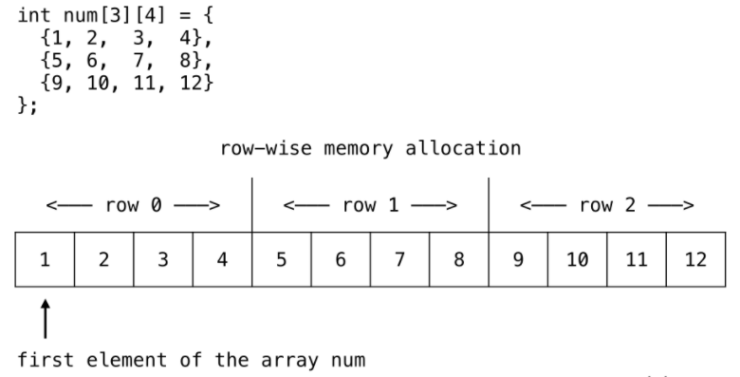
Matrix
Arrays can be defined with 2 dimensions, in this case will have 2 subindex.
To access one of its elements:
Read value_read = array_name [index_1] [index_2]
Write array_name [index_1] [index_2] = value_write

Slide 19
Structs
Diferent datatype variables grouped inside
Refenced by a name.
Elements from inside the struct can be accesed using ‘.element’ or ‘->element’ depending the case.
Declared using the reserved Word “struct”
struct struct_name {
type element_1;
. . .
type element_N;
};
Declaration and initialization of a variable of type struct:
struct struct_name var_name = {val_1, …, val_n};
Access elements of the structure :
var_name.element_n = new_value;

Slide 20
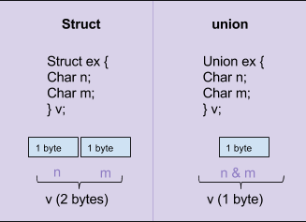
Unions
Special datatype.
Allows to allocate different types in the same memory space.
Variables inside the union can be accessed using the same notation used in strutctures. unionName.variableName.
Very used in embedded to have direct access to different bytes from a word.

Slide 21
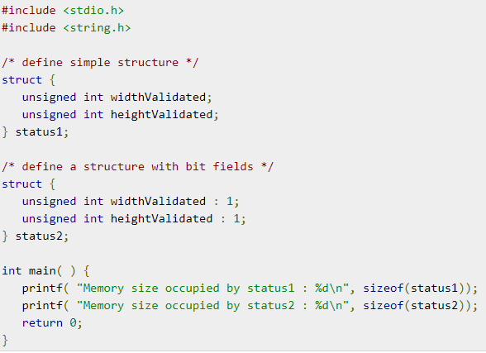
Bitfield
Natural way to operate with bits
Efficient RAM utilization
Help to make code clear
Improve speed when operate with bits
Easy way to manipulate uControlers registers

Slide 22
Enumeration
Assign successive integers constant numbers to different tags.
Numbers assigned to each tag can be “hard coded”
Used to have better visibility inside the code.
Declaration of the enumeration:
enum days {MONDAY, TUESDAY, WEDNESDAY, THURSDAY, FRIDAY, SATURDAY, SUNDAY};
Declaration of a Variable of type enumeration:
enum days variable_name;
Assign a value:
variable_name = WEDNESDAY;

Slide 23
Pointers
03
02

Slide 24
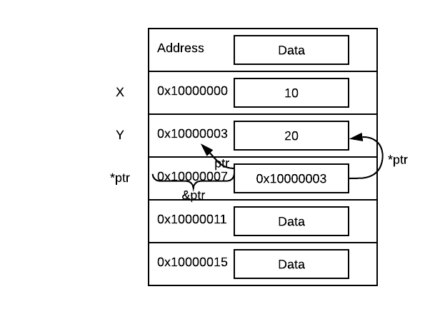
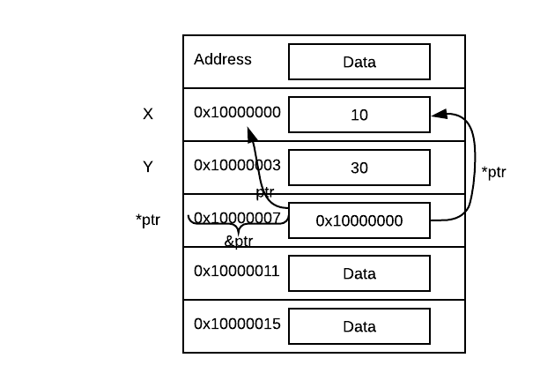
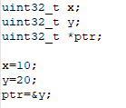
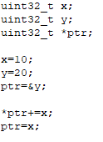
Pointers
Are variables that references to memory addreses.
A pointer is “pointing” to an specific memory position.
Unary operators: *(indirection) and &(reference)
*ptr will give you the value from the memory where the pointer is pointing.
&var will give you the memory address where the variable is allocated.
Syntax: data_type *pointer_name;

Slide 25
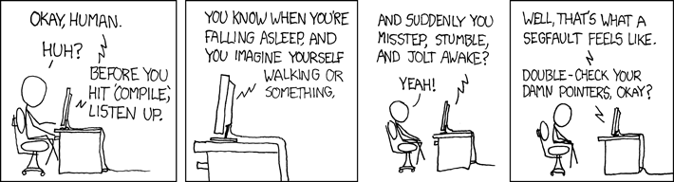
Pointers
Always check that the pointer is pointing to the correct place.
Is a good practice to initialize pointers with NULL.

Slide 26
Pointers arithmetic
uint8_t vector[100]; /* integer array */ uint8_t *ptr; /* uint8 pointer declaration */ ptr = &vector[0]; /* ptr points to vector initial address */
*ptr = 33; /* vector[0] = 33 */ *(ptr+1) = 44; /* vector[1] = 44 */ *(ptr+2) = 90; /* vector[2] = 90 */
uint16_t *ptr16; /* int16 pointer */
ptr16 = &vector[0]; /* ptr points to vector initial address */
ptr16 ++; /* vector[2] == *ptr16 */
Remember:
A pointer size has always the same size than the architecture address bus. Because it needs to save a address memory.
When you declare a pointer as an special datatype, ex. uint8_t you are specifying the pointer aritmethic.

Slide 27
Strings
Definition:
It is an array of characters that ends with a NULL ('\0')
The string name works as a pointer
Declaration and initialization:
char string_name [size] = "Hello"; // It must have 1 extra carácter
char string_name [] = "Hello"; // It is created automatically with 6 elements
char string_name [size];
Assign a value to a string:
strcpy(string_name, “new message");
Most used functions of the library <string.h>
strlen(string) // Length of the string, not including NULL
strcat(str1, str2) // Concatenate 'str2' to the end of 'str1'
strcpy(str1, str2) // Copy 'str2’ into 'str1'
strlwr(string) // Convert the entire string to lowercase
strupr(string) // Convert the entire string to UPPERCASE
strrev(string) // Invert the string
strcmp(str1, str2) // Compare two strings and returns 0, -1 or 1
strncat(str1, str2, n) // Concatenate the first 'n' char of ‘str2’ to the end of ‘str1’
strncpy(str1, str2, n) // Copy the first 'n' char from ‘str2’ to ‘str1’
strchr(string, char) // Returns a pointer to the first 'char' within the string
strstr(str1, str2) // Returns a pointer to the first 'str2' within 'str1'

Slide 28
Function pointer
Function pointers points to code, not data.
You can get the address where the code is stored using ‘&’ operator.
Syntax: return_datatype (*func_ptr)(parameter_datatypes) = function_name;
void fun(int a)
{
printf("Value of ‘a’ is %d\n", a);
}
int main()
{
void (*fun_ptr)(int) = fun; // & removed
fun_ptr(10); // * removed
return 0;
}

Slide 29
Modularization
04
02

Slide 30
Modularization
C provides different tools for code modularizing.
Remember to use source file .c and header files .h as its suppose.
You should only include your .h file from your main file.
You should provide a .h file for each .c file.
Header files should only have function prototypes and datatype that are suppose to be visible from the outside.
You can also use a .h file with an object .o file. In this case you can share functions without showing the implementation code.
You can use extern, static, weak, in order to have a better encapsulation.

Slide 31
Static, Extern, Volatile
Static declaration has two different ways to be use:
Local variable: The memory position used will be exclusive for this variable. This means that the compiler will not assign this value to another local or global variable in order to persist this value beyond the function existence.
Global variable: Declaring global variables as static will hide the variable in order to avoid been called from the outside.
Functions: Functions can be declared as static too. Will be not possible to invoke an static function from the outside.
Extern
Extern declaration is used to specify the compiler that an specific implementation is declared in an external file.
We should be careful when we try to hide some internal function. A function not declared in header file, but not declared as static can be still accessed from the outside knowing its prototype. You only need to declare it as extern from the outside and the linker will do the rest for you.
Volatile
This declaration is used to avoid compiler optimizations. You must use it when you are waiting for a variable to change and this change come from an external source (interruption, register…). The compiler can’t knew this, so it will try to optimize your condition as if the variable never change and this will end in an eternal no sense check.

Slide 32
Dynamic memory
05
02

Slide 33
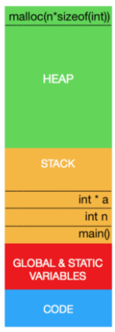
Dynamic memory allocation
#include <stdio.h>
#include <stdlib.h>
int first()
{
return 1;
}
int second()
{
return 2;
}
int main(int argc, char ** argv)
{
first();
int n = second();
printf("Hello World \n");
int * a = (int *) malloc(n * sizeof(int));
/* Do something here with 'a' */
*a = first();
printf("a = %d", *a);
free(a);
return 0;
}
Stack and heap are always growing and decreasing.
Both start from different extremes and get closer as bigger they are.
Heap grow up with dynamic allocation memory.
Stack grow up with function nesting.
Memory leakage is when Heap grow up over the border line delimited by stack. Programmers must be very careful and free all assigned dynamic memory that is no longer used.
Stack overflow is when stack grow up over heap limit. This normally happens with recursive function calling.

Slide 34
Dynamic memory allocation
Functions:
Malloc: malloc function is used to ask for a memory block in the heap syntax: datatype *ptr = (*data_type) malloc(size_in_bytes);
Free: free is used to release memory block that are not used anymore
syntax: free(block_pointer);
Realloc: realloc is used to resize a memory block that is already allocated in the heap
syntax: datatype *ptr = (* data_type) realloc(actual_block_pointer, new_size_in_bytes);
Calloc: initialize a memory block using as attributes a size and a number of items
syntax: datatype *ptr = (*data_type) calloc(item_numbers, size_in_bytes);

Slide 35
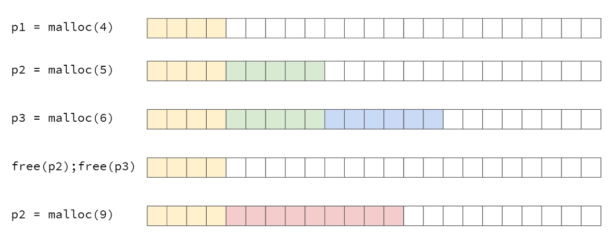
Dynamic memory allocation

Slide 36
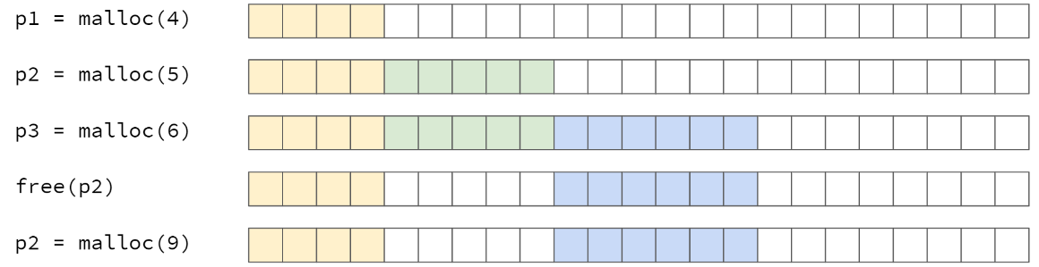
Dynamic memory allocation: Fragmentation
Error: Not enough space in memory

Slide 37
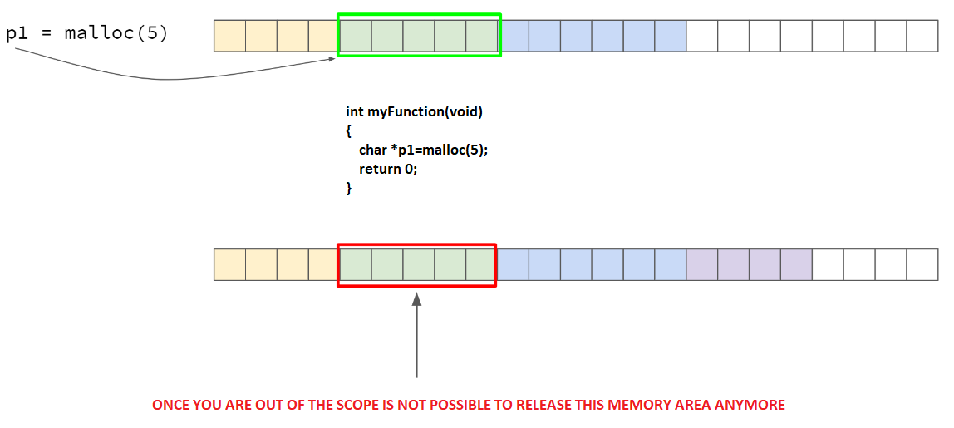
Dynamic memory allocation: Memory leak

Slide 38
Dynamic memory allocation: Early release
This should not be done!
But if there is no change in context, this works well
If there is a change of context ...
The memory location may or may not be overwritten
char * p1;
p1 = malloc(10); free(p1);
strcpy(p1, ”HELLO”); printf(“%s”, p1);
Context change
(Interruption, switch to another thread, running on another core or OS multi-tasking)
char * p1;
p1 = malloc(5);
strcpy(p1, “HI”);
printf(“%s”, p1)
free(p1);
Lesson learned:
The "free" always goes last

Slide 39
Lists and recursion
06
02

Slide 40
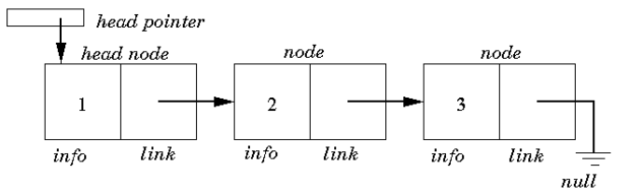
Linked lists
Dynamic way to handle with structured data
Easy way to manage sorted data
Easy to navigate

Slide 41
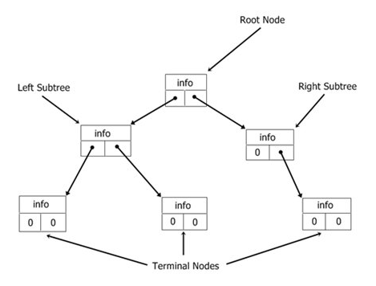
Binary trees
Provide an efficient way to manage sorted data
Special form of linked list
Items can be accessed, deleted and inserted in any order
New item creation should follow an ordered method.
Binaries trees can be balanced in order to ensure a better seek time.
Traversing − Traversing means passing through nodes in a specific order.
Basic Operations
Insert − Inserts an element in a tree/create a tree.
Search − Searches an element in a tree.
Preorder Traversal − Traverses a tree in a pre-order manner.
Inorder Traversal − Traverses a tree in an in-order manner.
Postorder Traversal − Traverses a tree in a post-order manner.

Slide 42
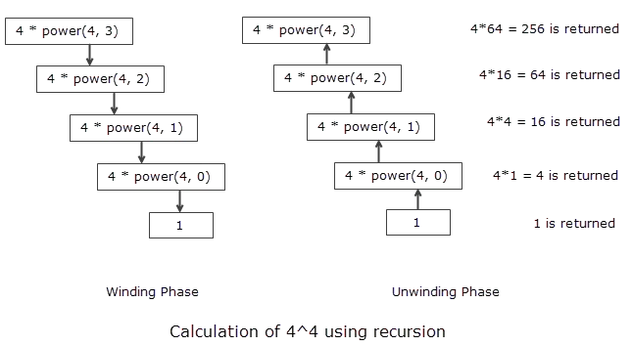
Recursion
Are the functions that called itself
Very useful when we need to do an iterative algorithm, like a seek in a binary tree
Complex behaviour with few code lines
As we are using a self calling function we should understand that this will increase a lot the used stack memory.

Slide 43
Finite State Machines
07
02

Slide 44
Finite State Machines - FSM
Introduction to general concepts
It is used to describe systems whose behavior depends on current events and events that occurred in the past.
At each instant of time the machine is in a specific state. Depending on the inputs the machine changes or does not change state and can perform actions that affect the system.
Programs that interact with the user (for example, keyboard, display, data entry, alarms, etc.) are likely to fit into this methodology.
A program with a "finite state machine" is easy to maintain because you can add or remove states without changing the rest.

Slide 45
Finite State Machines - FSM
Input == 0
Definitions
States: Estado inicial + otros estados fijos o temporales
Inputs: External inputs, timeouts, variables from other state machines, etc…
Outputs: Activate/Deactivate outputs, update variable values, reset counters, etc…
State A
Output = 1
State B
Input == 1
Output = 0
Output = 0
Time == 10
Time == 10
Output = 0
Input == 1
State C
Reset_all
State D
Input == 0
Output = 1
Time == 1
~Output

Slide 46
Finite State Machines - FSM
Implementation (1/2)
// List all available states
typedef enum
{
STATE_INITIAL,
STATE_1,
STATE_2,
/* ... */
STATE_N
} state_t;
// Global state variable
state_t currentState;
// Functions prototypes
void InitializeFSM(void);
void UpdateFSM(void);
// Main program
int main (void)
{
// Initialize all state machines
InitializeFSM();
// Infinite loop
while(1)
{
// Update all state machines
UpdateFSM();
}
return 0;
}
void InitializeFSM(void)
{
// Set the initial state
currentState = STATE_INITIAL;
/* Set Outputs */
/* Set variables */
}

Slide 47
Finite State Machines - FSM
Implementation (2/2)
void UpdateFSM(void)
{
switch(currentState)
{
case STATE_INITIAL:
{
// Check the conditions for changing state
if(condition == TRUE)
{
// Change the state
currentState = STATE_N;
/* Update the Outputs */
/* Update the variables */
}
break;
}
case STATE_1:
{
/* ... */
break;
}
case STATE_N:
{
/* ... */
break;
}
default:
{
// There was an error
// Let's initialize everything
InitializeFSM();
break;
}
}
}

Slide 48
Finite State Machines - FSM
Init FST 1
Adding more state machines
Add the initialization function
Add the update function
Init FST 2
Init FST n
Update FST 1
Update FST 2
Update FST n

Slide 49
Threads
08
02

Slide 50
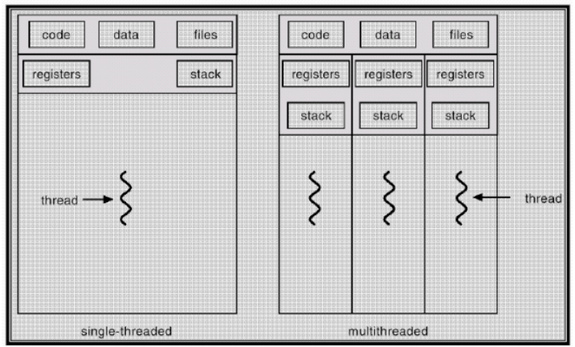
Thread
A thread is a single sequence stream within in a process. Because threads have some of the properties of processes, they are sometimes called lightweight processes.
In C we will use pthread library, you can use detach or joinable threads.
Creation is much faster than processes.
Context switching between threads is much faster than processes.
Threads inside a same process share the same memory space.
Communication between threads is faster.
Need to use semaphores in order to manage memory space.

Slide 51
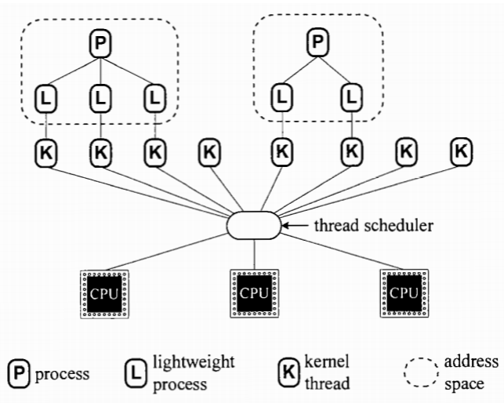
Threads lightweight
Inside user space but handled by a kernel thread
Use kernel resources
Real parallelism
Syscall to create and kill threads

Slide 52
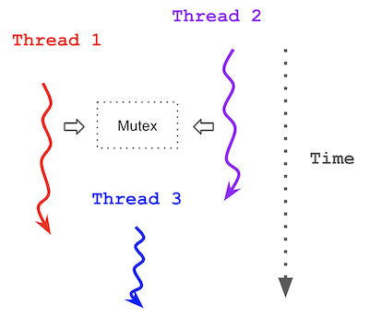
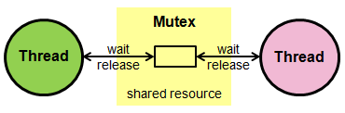
Mutex
We will need a mechanism in order to access shared resources
Will lock a resource in order to let a process work without risks.

Slide 53

Vienna, Austria (Headquarters) | Germany | USA | Japan | China
Phone +43 1 585 65 38-5000 office@tttech-automotive.com | Phone +49 841 88 56 47-0 office@tttech-automotive.com | Phone +1 978 933 7979 usa@tttech.com | Phone +81 52 485 5898 office@tttech.jp | Phone +86 21 5015 2925-0 china@tttech.com
www.tttech-automotive.com
Copyright © TTTech Automotive GmbH. All rights reserved.

